Slide 1

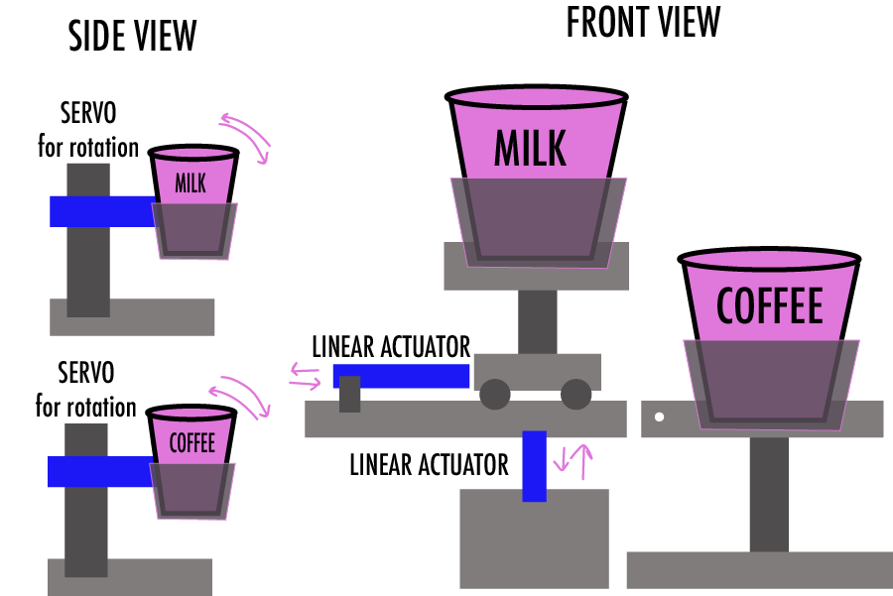
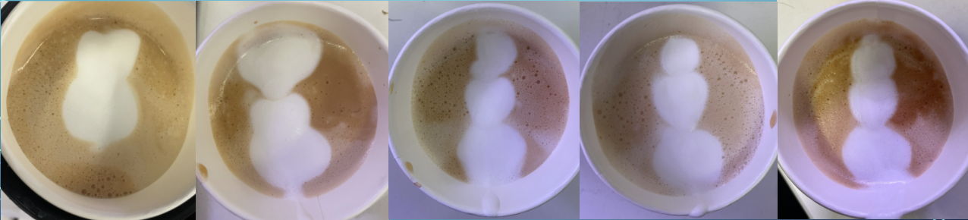
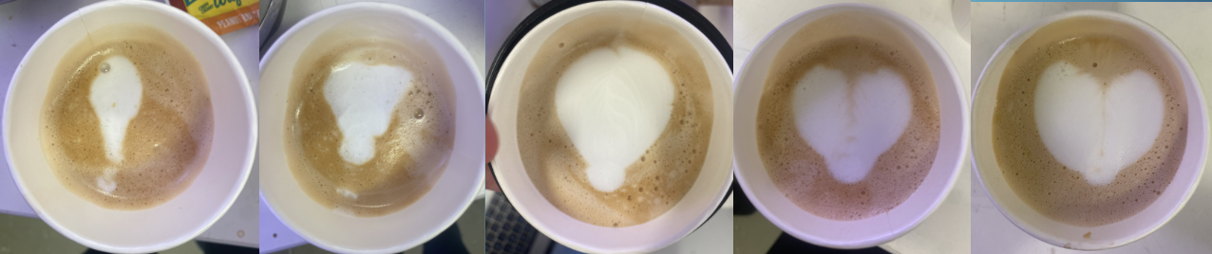
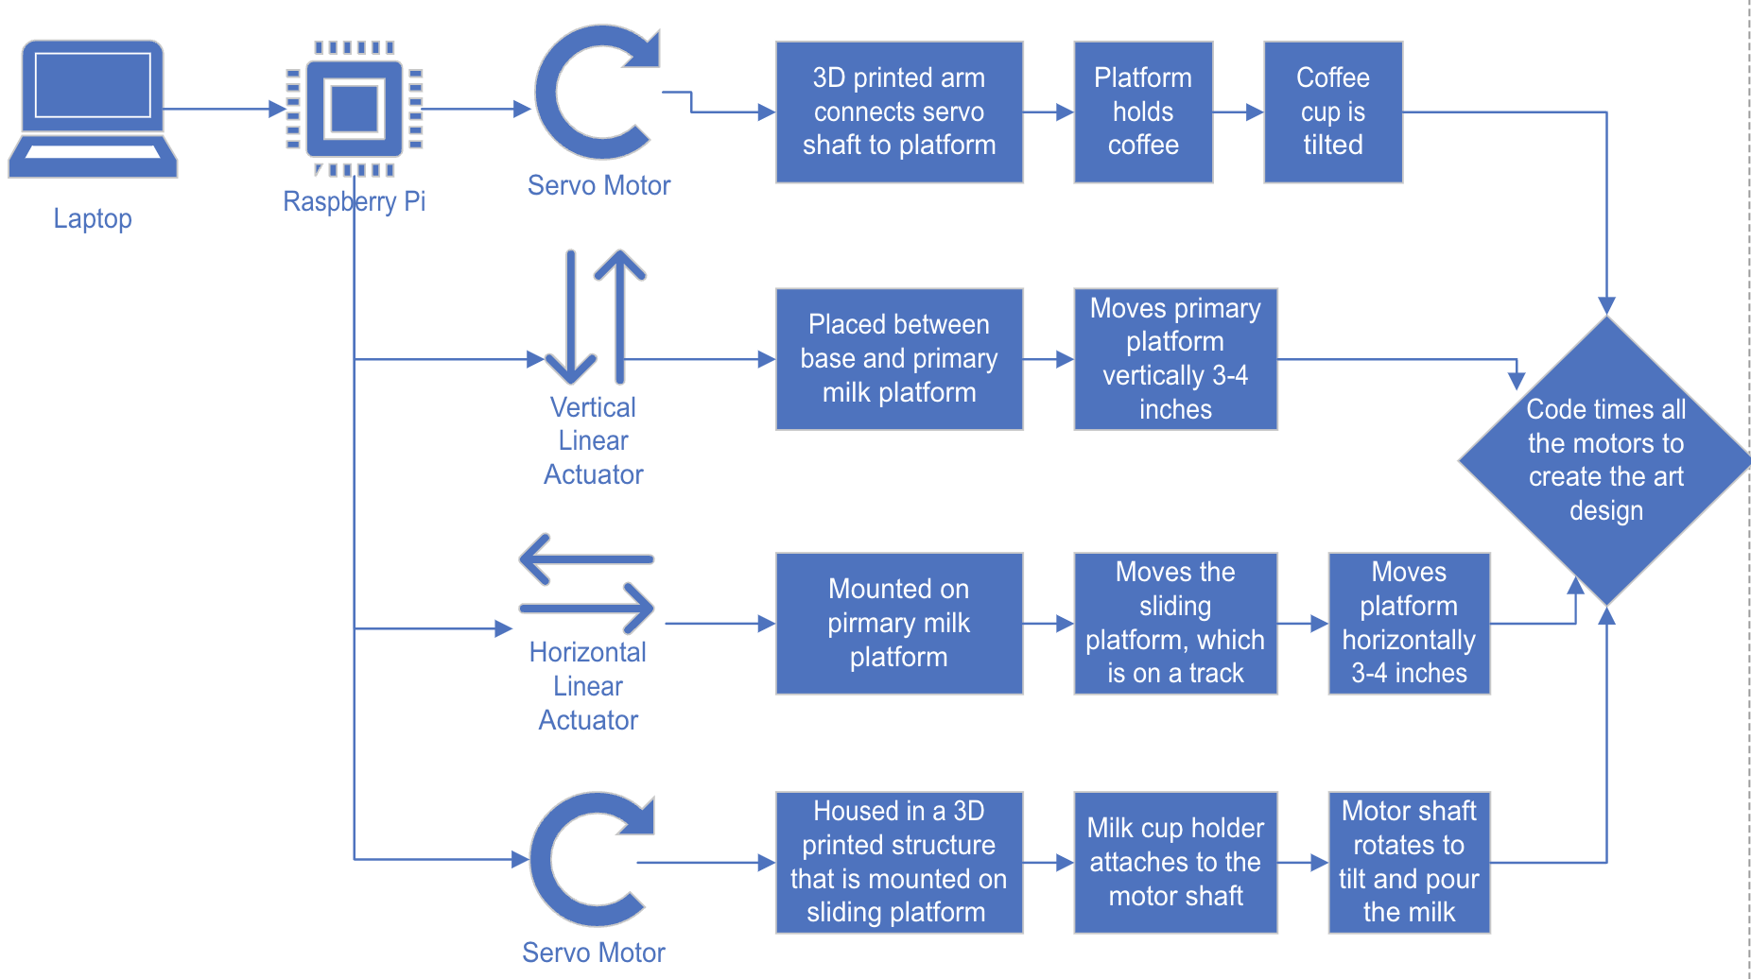
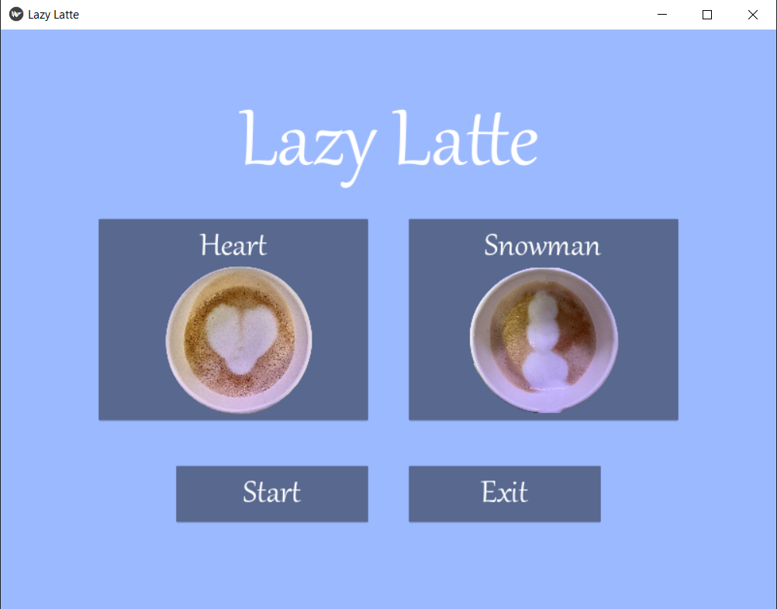
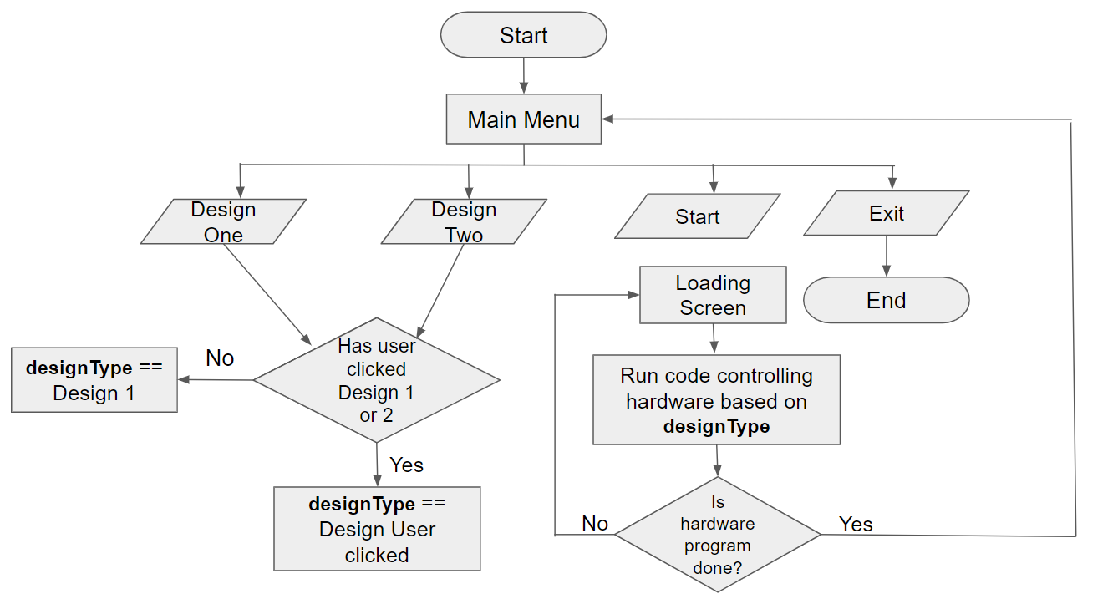
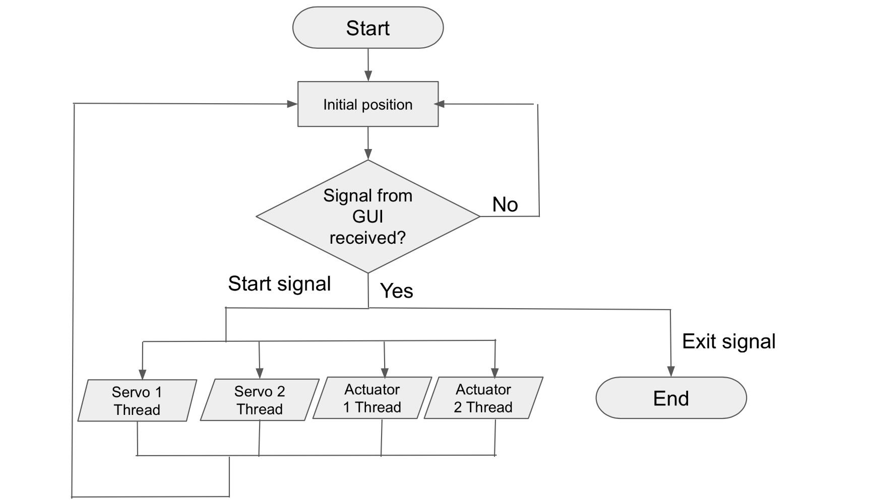
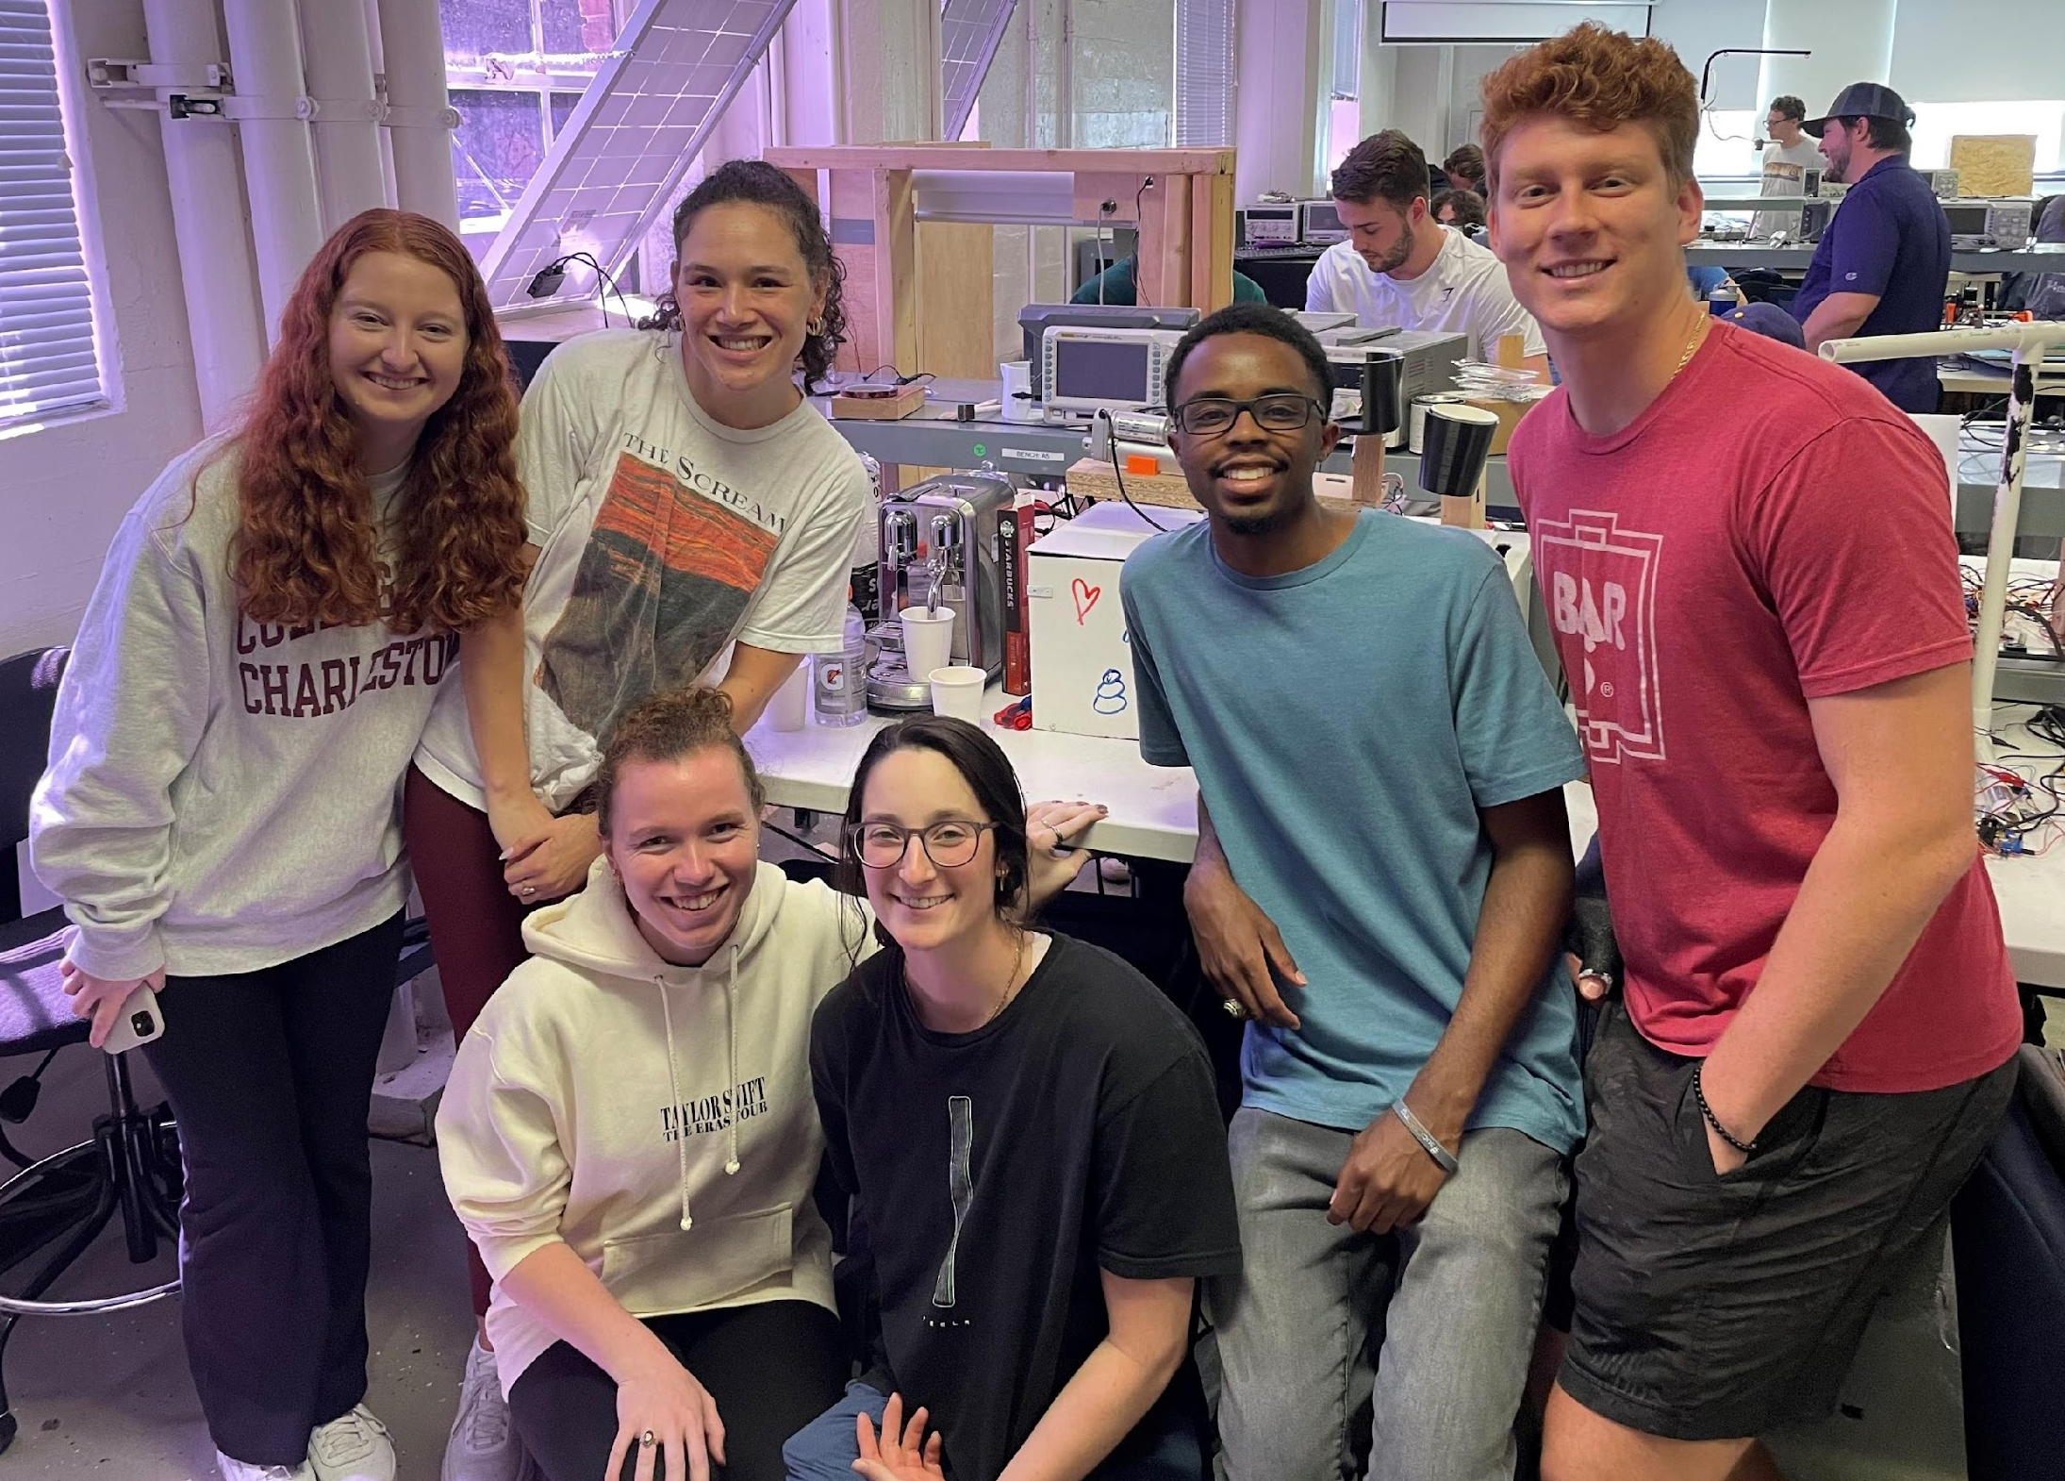
Automated Latte Art Machine
ECE 4960
Team 4
Jacqueline Bendziewicz, Leah Brown, Elise Ferkler, Derrick Joyce, Mariah Tam, Luke Swetonic
Holcombe Department of Electrical and Computer Engineering, Clemson University, Clemson, SC
Abstract
Hardware Implementation
Results
Latte art is the process of pouring microfoam on the surface of espresso-based coffee beverages to create aesthetically pleasing patterns and designs. This art form is immediately recognizable in the coffee community, but usually only mastered by skillful baristas. The typical challenges include:
Milk temperature and consistency
Pouring speed
Tilting angles
Reproducible designs
Objective: Create an automated latte art machine that can pour a snowman and heart latte art design with a cup of espresso and a cup of steamed milk.
Figure 6. Snowman Latte Art Progression
Figure 7. Heart Latte Art Progression
Figure 2. Automated Latte Art Machine Prototype Design
Conclusions
Introduction
Software Implementation
Snowman and heart latte art designs were successful, but difficult to reproduce consistently
Milk type, consistency, and temperature is just as important as motor precision.
Hardware PWM significantly reduced servo jitter which is important when handling liquids and electronics.
Kivy Python Library was used to create the GUI. Kivy allows for event handling and custom callback functions. These are the steps to successfully order a latte:
1. The user will have the choice of pouring a heart or snowman latte art design via a visual GUI.
References
Figure 3. GUI Main Menu
[1] “Gpiozero,” gpiozero. [Online]. Available: https://gpiozero.readthedocs.io/en/stable/.
[2] M. Bilal, “Ampere debuts 80-core arm server processor,” PIC Microcontroller, 11-Apr-2020. [Online]. Available: https://pic-microcontroller.com/ece-4760-latte-art-machine/amp/.
[3] Sebastian, “GPIO programming on the Raspberry Pi: Python libraries,” Medium, 31-Aug-2021. [Online]. Available: https://medium.com/geekculture/gpio-programming-on-the-raspberry-pi-python-libraries-e12af7e0a812.
2. The selection is stored in the variable ‘designType’ and evaluated.
To confirm selection, the user will press ‘Start’.
Figure 1. Automated Latte Art Machine Block Diagram
Table 1. Hardware and Software Requirements
Figure 4. GUI Flowchart
Acknowledgements
Hardware Requirements | Software Requirements
Raspberry Pi 4B | Python & Visual Studio Code
1 x Motor Driver | Servo rotation as degrees
2 x Linear Actuators | Actuator movement as inches
2 x Servo Motors | Threading to run all hardware components simultaneously
2 x Drawer Sliders | GUI to allow user selection
3D Printed Milk and Coffee Cups | Hardware PWM to reduce servo jitter
This work was supported by Clemson University’s Holcombe Department of Electrical and Computer Engineering.
We acknowledge Dr. Hassan Raza and the Mechanical Engineering Student Shop.
Figure 8. Jacqueline Bendziewicz, Mariah Tam, Elise Ferkler, Leah Brown, Derrick Joyce, and Luke Swetonic
3. ‘Start’ prompts the machine to initialize. The appropriate thread which begin containing specific commands to complete the design.
This process repeats until the user selects ‘Exit’.
Figure 5. Motor Flowchart

